Slide 1
NAMING WORDS AND THEIR PLURALS
Name of people, places and things are naming words.
Naming words that name one person, place or thing are singular. Those that name more than one person, place or thing are plural.

Slide 2
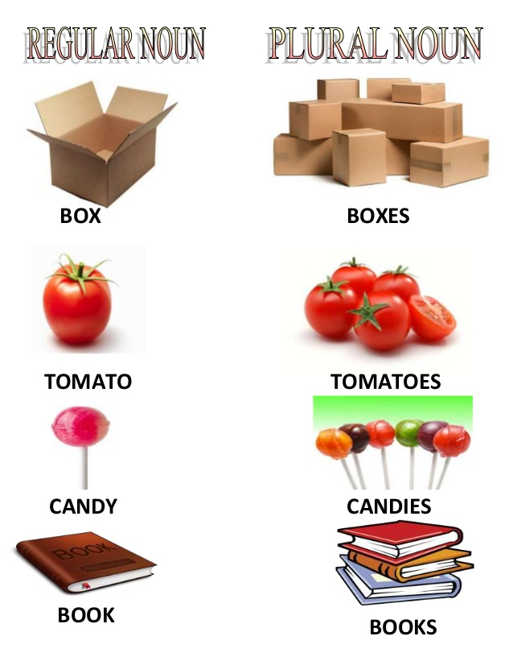
SINGULAR AND PLURAL

